Slide 1
Computer Networks (CS-241)
Dr. Syed Muhammad Mohsin
Department of Computer Science,
University of Wah
Adapted From:
Computer Networking: A Top-Down Approach 8th edition: Jim Kurose, Keith Ross Pearson, 2020

Slide 2
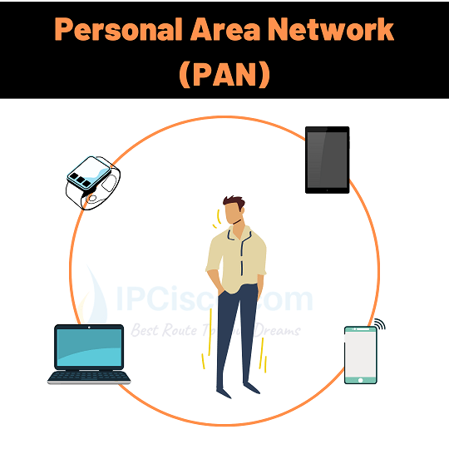
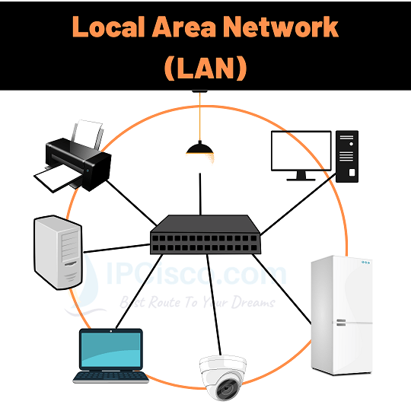
Types of Computer Networks (1/3)
PAN – Personal Area Network
A PAN is the smallest type of network, designed for a single person’s devices within a very small area (a few meters).
Key Features:
Covers a few meters (like around a person’s desk)
Used for connecting personal devices such as laptops, smartphones, tablets, printers, etc.
Examples:
Connecting a smartphone to a laptop via Bluetooth or hotspot.
A wireless headset connected to a mobile phone.
A USB-connected printer or mouse.
LAN – Local Area Network A LAN connects computers and devices in a limited geographical area such as a home, office, or building.
Key Features:
High data transfer rates (up to 1 Gbps or more)
Privately owned and managed
Usually uses Ethernet cables or Wi-Fi
Examples:
Computers connected in a university lab or office.
A Wi-Fi network in a home or school.
A small company’s internal network.

Slide 3
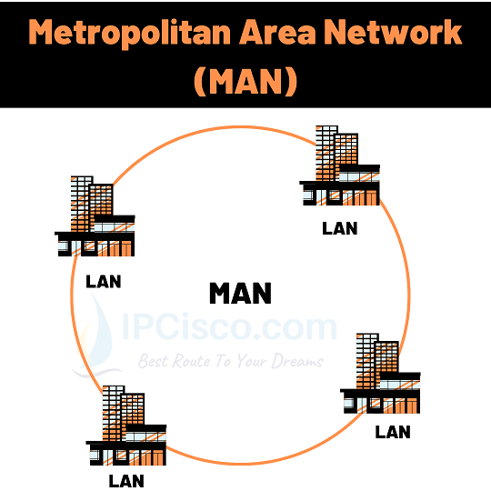
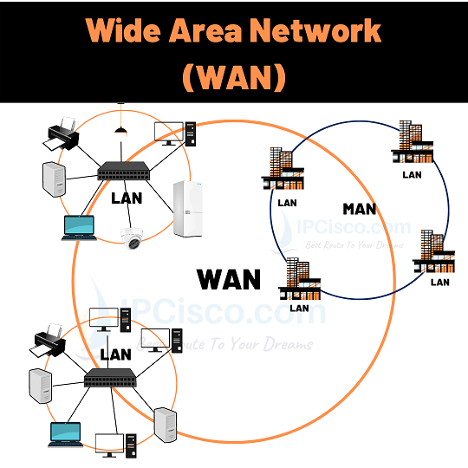
Types of Computer Networks (2/3)
MAN – Metropolitan Area Network A MAN covers a larger area than a LAN — typically a city or campus — and interconnects multiple LANs.
Key Features:
Spans across a city or large campus
Can be owned by an organization or managed by an Internet Service Provider (ISP)
Uses high-speed fiber optic connections
Examples:
A university’s campus network connecting different buildings.
City-wide Wi-Fi or cable TV networks.
A government department’s network across multiple city offices.
WAN – Wide Area Network
A WAN covers a very large geographical area — a country, continent, or even the whole world. It connects multiple MANs and LANs.
Key Features:
Covers large distances
Uses satellite links, undersea cables, or leased telephone lines
Managed by multiple organizations or service providers
Examples:
The Internet (largest WAN in the world).
A multinational company’s private network connecting offices in different countries.
A bank’s inter-branch communication network.

Slide 4
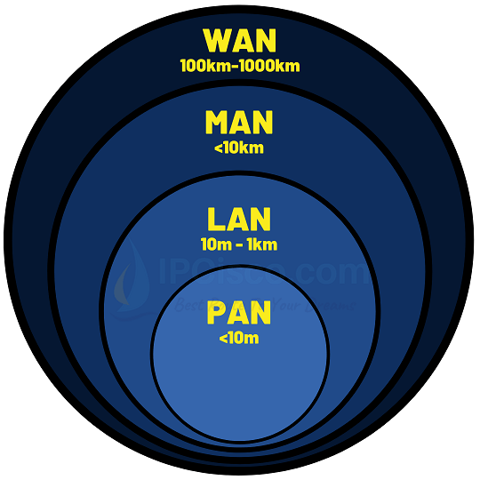
Types of Computer Networks (3/3)
Type | Full Form | Coverage Area | Ownership | Example
PAN | Personal Area Network | A few meters | Individual | Bluetooth between phone and laptop
LAN | Local Area Network | Building or campus | Private | Office network, home Wi-Fi
MAN | Metropolitan Area Network | City or campus | Organization/ISP | University or city-wide network
WAN | Wide Area Network | Country or global | Multiple organizations | Internet, corporate WAN

Slide 5
Types of Data Communications (1/4)
Data communication refers to the exchange of data between two devices through some transmission medium (like cables or wireless signals). The direction in which data can flow between sender and receiver defines the type of communication.
1. Simplex Communication (Sender → Receiver):
In Simplex, data flows only in one direction — from the sender to the receiver. The receiver cannot send back any data or response.
Key Features:
One-way communication
Sender only transmits; receiver only receives
Used where no feedback is required
Examples:
Keyboard → CPU
Monitor ← CPU (display output)
Television broadcasting

Slide 6
Types of Data Communications (2/4)
2. Half Duplex Communication (Sender ⇄ Receiver (but one at a time)):
In Half Duplex, data flows in both directions, but only one direction at a time. The sender and receiver take turns to send or receive data.
Key Features:
Two-way communication, but not simultaneous
One device must wait while the other transmits
Reduces collisions but is slower than full duplex
Examples:
Walkie-talkies (one speaks while the other listens)
Police radio systems
Traditional CB* radio communication
*CB (Citizens Band) Radio is a two-way radio communication system that allows individuals to communicate over short distances using radio frequency channels without needing a license.

Slide 7
Types of Data Communications (3/4)
3. Full Duplex Communication (Sender ⇄ Receiver (simultaneous)):
In Full Duplex, data flows in both directions simultaneously. Both devices can send and receive data at the same time.
Key Features:
Two-way communication at the same time
More efficient and faster than half duplex
Requires two separate communication channels (one for each direction)
Examples:
Telephone conversations
Video calls
Modern computer networks (Ethernet, Wi-Fi)

Slide 8
Types of Data Communications (4/4)
Type | Direction of Data Flow | Simultaneous Communication | Examples
Simplex | One-way only | No | Keyboard to CPU, Monitor display
Half Duplex | Both ways (one at a time) | No | Walkie-talkie, CB radio
Full Duplex | Both ways (simultaneous) | Yes | Telephone, Internet communication

Slide 9
Network Topologies (1/6)
A network topology refers to the physical or logical layout of how computers, cables, and other network devices are connected in a network. It shows how data flows between nodes (devices).
1. Bus Topology
All computers and devices are connected to a single central cable called the bus or backbone.
Advantages:
Easy to install and inexpensive (uses less cable)
Works well for small networks
Disadvantages:
If the main cable fails, the entire network stops working
Data collisions can occur when two devices send data at the same time
Difficult to troubleshoot
Examples:
Early Ethernet networks
Small temporary networks

Slide 10
Network Topologies (2/6)
2. Star Topology
All devices are connected to a central hub or switch. The hub acts as a repeater to transmit data between devices.
Advantages:
Easy to install and manage
Failure of one cable doesn’t affect others
Easy to add or remove devices
Disadvantages:
If the central hub/switch fails, the whole network goes down
Requires more cable length than bus topology
Examples:
Modern Ethernet networks in offices or homes
Wi-Fi networks using a router as a central point

Slide 11
Network Topologies (3/6)
3. Ring Topology
Each device is connected to two other devices, forming a closed loop (ring). Data travels in one direction (or both in dual ring).
Advantages:
Data flows in an orderly manner (less collision)
Performs better under heavy load than bus topology
Disadvantages:
If one device or cable fails, the whole network may stop
Difficult to troubleshoot and modify
Examples:
Token Ring networks (IBM)
Some fiber-based MANs

Slide 12
Network Topologies (4/6)
4. Tree Topology (Hierarchical Topology)
A combination of Star and Bus topologies. Devices are arranged in a hierarchical structure — like branches of a tree — with a root node and sub-nodes.
Advantages:
Scalable and easy to expand
Easy to manage and detect faults
Supports large networks
Disadvantages:
If the main hub fails, the entire section goes down
Requires a lot of cables and hardware
Examples:
Corporate networks (universities, enterprises)
Used in Wide Area Networks (WANs)

Slide 13
Network Topologies (5/6)
5. Mesh Topology
Every device is connected to every other device directly. There are two types:
Full Mesh: All devices interconnect directly.
Partial Mesh: Only some devices are interconnected.
Advantages:
Very reliable — no single point of failure
Data can take multiple paths to reach destination
High performance and security
Disadvantages:
Expensive due to large cabling and configuration
Complex to manage
Examples:
Internet backbone connections
Military or mission-critical networks

Slide 14
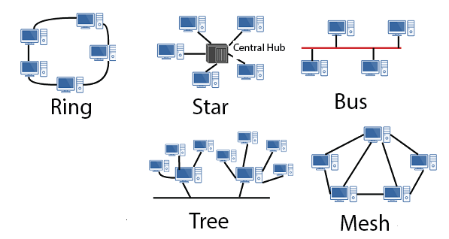
Network Topologies (6/6)
Topology | Layout Description | Advantages | Disadvantages | Example
Bus | Single backbone cable | Cheap, simple | Cable failure affects all | Early LANs
Star | All devices connect to hub | Easy to manage | Hub failure affects all | Modern LANs
Ring | Devices in a closed loop | Orderly data flow | One failure breaks network | Token Ring
Tree | Hierarchical structure | Scalable | Hub failure affects section | University networks
Mesh | Devices interconnect | Reliable, fast | Expensive, complex | Internet backbone

